Slide 1

Team F: We Don’t Want An F
Chang Dylan Einstein Eli ZeAi

Slide 2
Vision Statement
Get a broader range of basic information about classes
Rate level of difficulty, amount of homework, teaching techniques, and etc.
Provide a platform for students to post comment and questions and interact with each other
Help students to gain possible benefits of mentorship
Notes:
Finding a mentor is important to success in college and has many benefits such as providing the student advice, support and helping them develop good habits. There is a lack of mentorship in colleges as many students find it hard to connect with upperclassmen or faculty. We are making an app to help younger students gain the benefits of mentorship easily. Currently, the best way to find a student mentor is through clubs and activities. However, there is no certainty that these places will create a beneficial relationship. Our app creates an open forum that allows students to comment on their past classes. Younger students can use these comments to learn important tips about their classes, taking notes, complelting homework and more. These comments are availble to everyone to allow for less barries. Our app will then take averages of these and display result. A similar system would be to rate my professor. We differ as we focus more on the individual classes and make a connection between past students and current students.
For each class there will be a comment section. Under this section past students can answer a set of pre-determed questions (e.g.: What advice would you give a new student) or post a general one. The app will also allow users to rate important aspects of the class such as difficulty, amount of homework, and teaching techniques (Visual, Auditory, Kinesthetic). The rating system will prompt users to choose from a list of options for each questions (e.g.: easy medium hard).
-> ever been in the situation of wondering what a class contains
-> mentorship
-> post and comments
-> say names

Slide 3
Prototype Demo

Slide 4
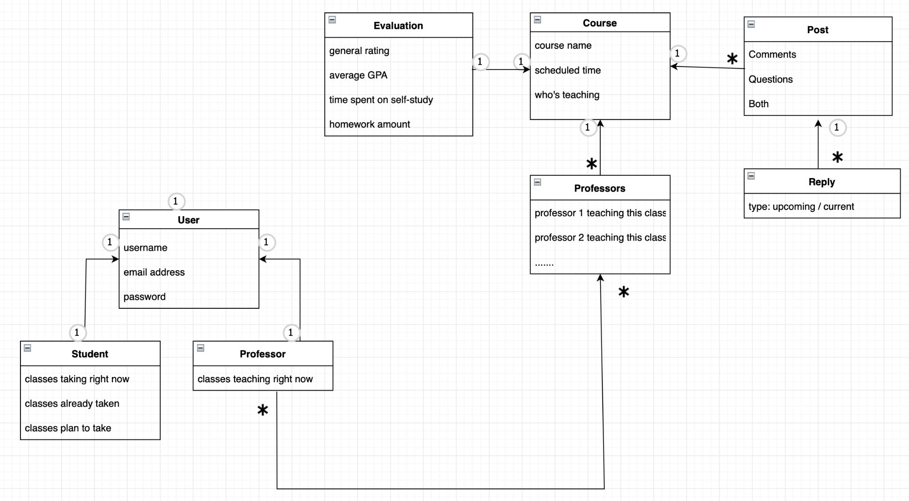
Domain Model
Domain Model

Slide 5
Database schema
class (ID, longName, shortName, subject)
users(ID, name, emailAddress, position)
userClass(ID, userID, classID)
rating(ID, ClassID, stars, homework, diff, book)
post( ID, classID, question, userID, date, test)
reply(ID, postID, userID, text)

Slide 6
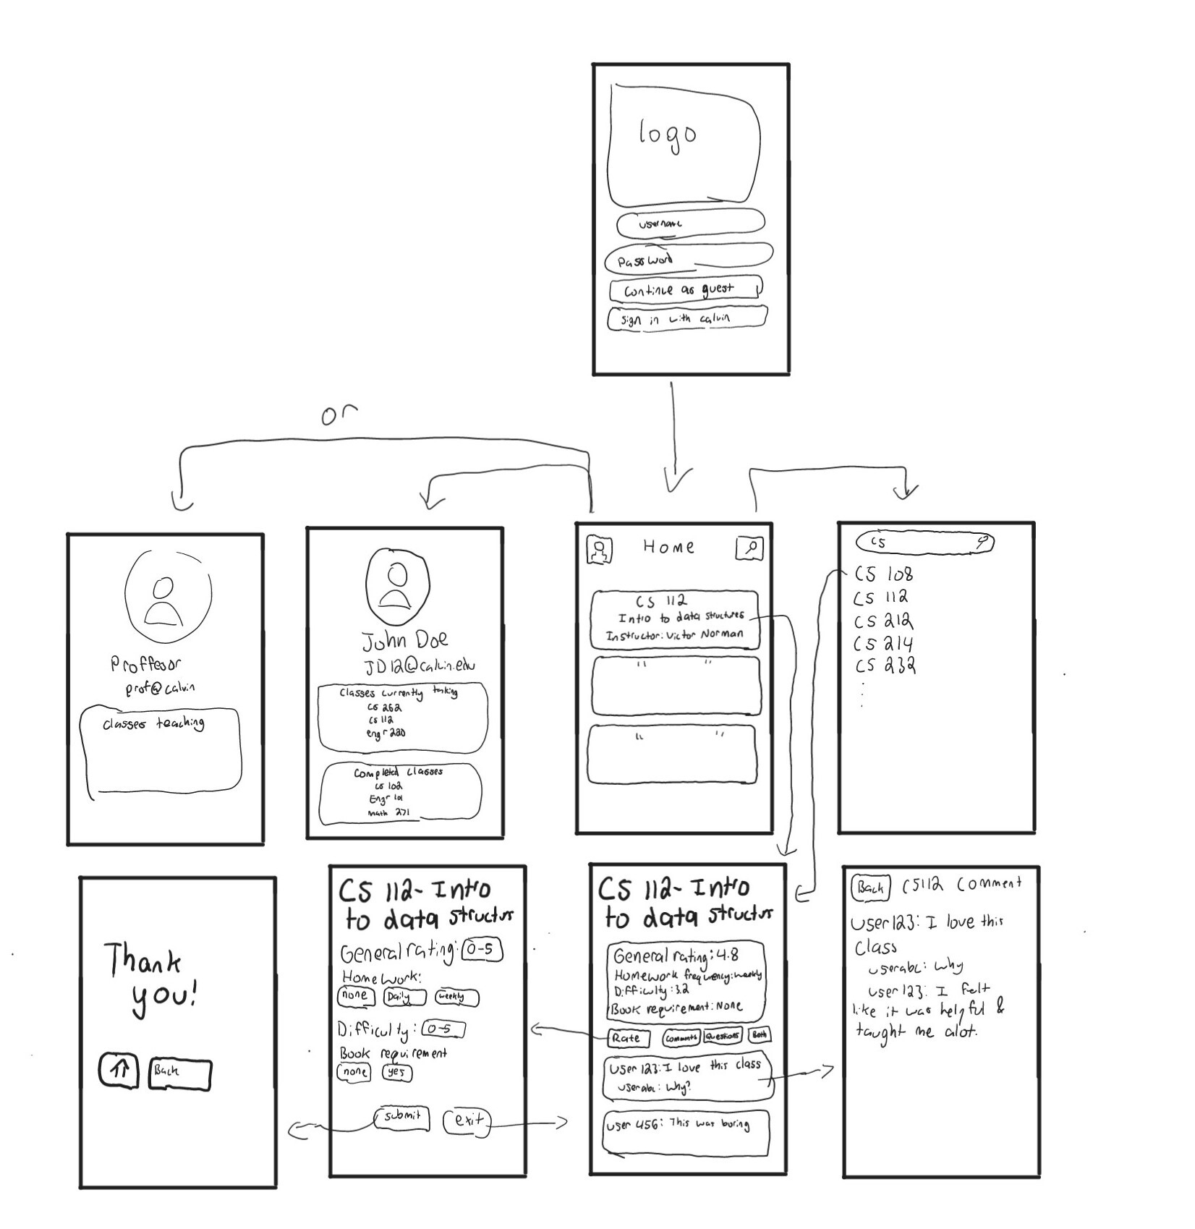
Status Report
Yet to accomplish:
Database
Customize homepage
Improve course detail page
One to one mentor

Slide 7
Questions?

Slide 8
Thank you for listening!

